Slide 1
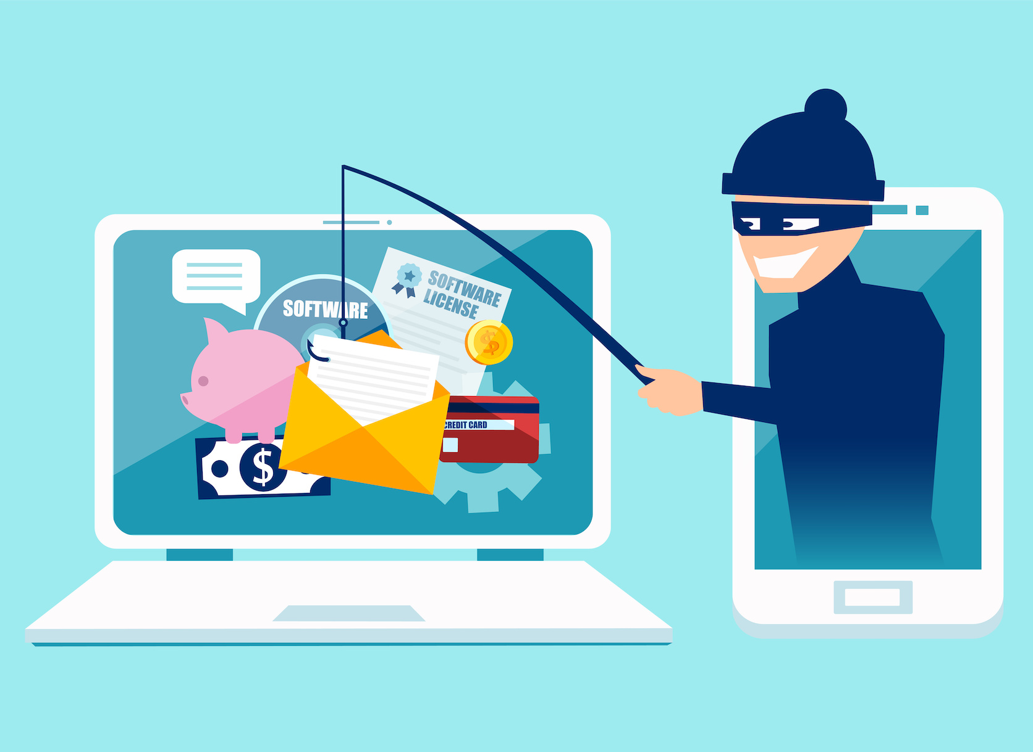
Beware of the Bait:
Familiarize yourself with phishing attacks

Slide 2
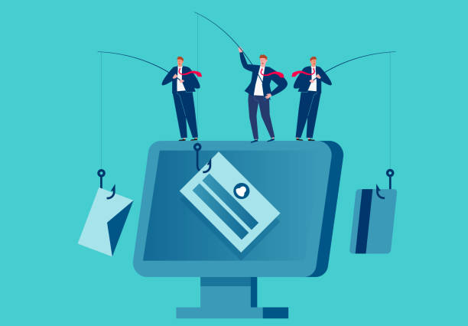
What is phishing?
Phishing attacks are attempts by cybercriminals to trick you into giving away sensitive information like passwords, credit card numbers, or personal details.These attacks are typically carried out through emails, but can also occur via text messages or phone calls.
Think of it as a fake email or message that "fishes" for your personal data.

Slide 3
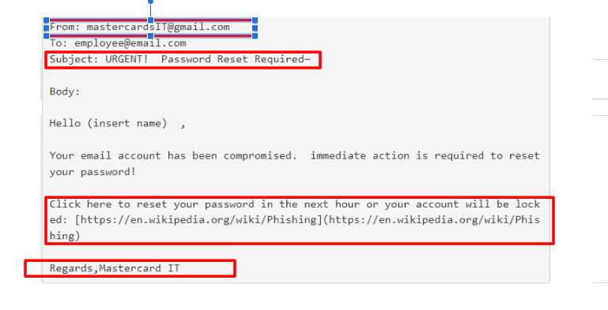
Learn to spot phishing emails
Check the Sender:
Look at the email address closely.
Look for Errors:
Spelling and grammar mistakes are red flags.
Generic Greeting:
Legitimate companies usually address you by name.
Verify Links:
Hover over links to see the actual URL.
Be Skeptical:
If it sounds too urgent or too good to be true, it probably is.

Slide 4
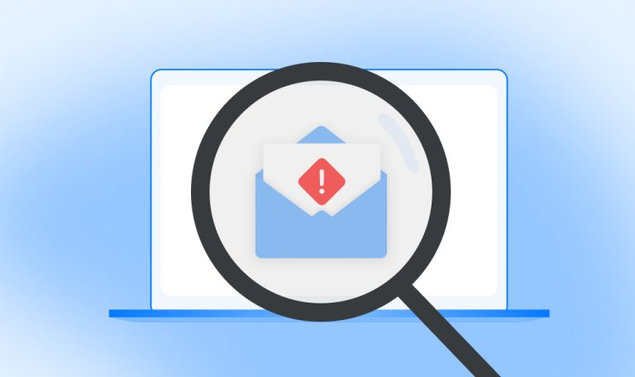
How do we stop getting phished?
Stay Informed: Regularly update yourself on the latest phishing tactics.
Verify First: Always double-check with the sender before clicking any link or providing information.
Use Security Tools: Make sure your antivirus and anti-phishing software are up to date.
Report Suspicious Activity: If you suspect a phishing attempt, report it to our IT department immediately.
Urgent Language: "Act Now!" or "Immediate Action Required!"
Suspicious Links: Hover over links to see the real URL.
Attachments: Unexpected files or attachments

